Slide 1
Chapter 6: Formal Relational Query Languages

Slide 2
Sets
$S=\{a, b, c\}$-- a set $S$ contains $a$, $b$ and $c$.
$a  S$-- $a$ is an element of set $S$.
$a  S$ -- $a$ is not an element of set $S$.
$\{x  S | P(x)\}$ is the set of $x$ from $S$ such that the predicate $P(x)$ is true.

Slide 3
Relations between sets
Let $A$ and $B$ be sets.
$A$ is a subset of $B$ such that $A$ $⊆B$, if and only if very element of $A$ is also an element of $B$.
𝐴 is not a subset of 𝐵 such that $A  B$, if some element of 𝐴 is not an element of 𝐵.
$A$ is equal to $B$. $A=B$, if and only if $A⊆B$and $B⊆A$.

Slide 4
Relational Algebra
Six basic operators
select: σ
project: ∏
union: ∪
set difference: –
Cartesian product: x
rename: ρ
The operators take one or two relations as inputs and produce a new relation as a result.
We first discuss relational algebra based on sets (or single-set), and then we discuss how to extend it to multisets.

Slide 5
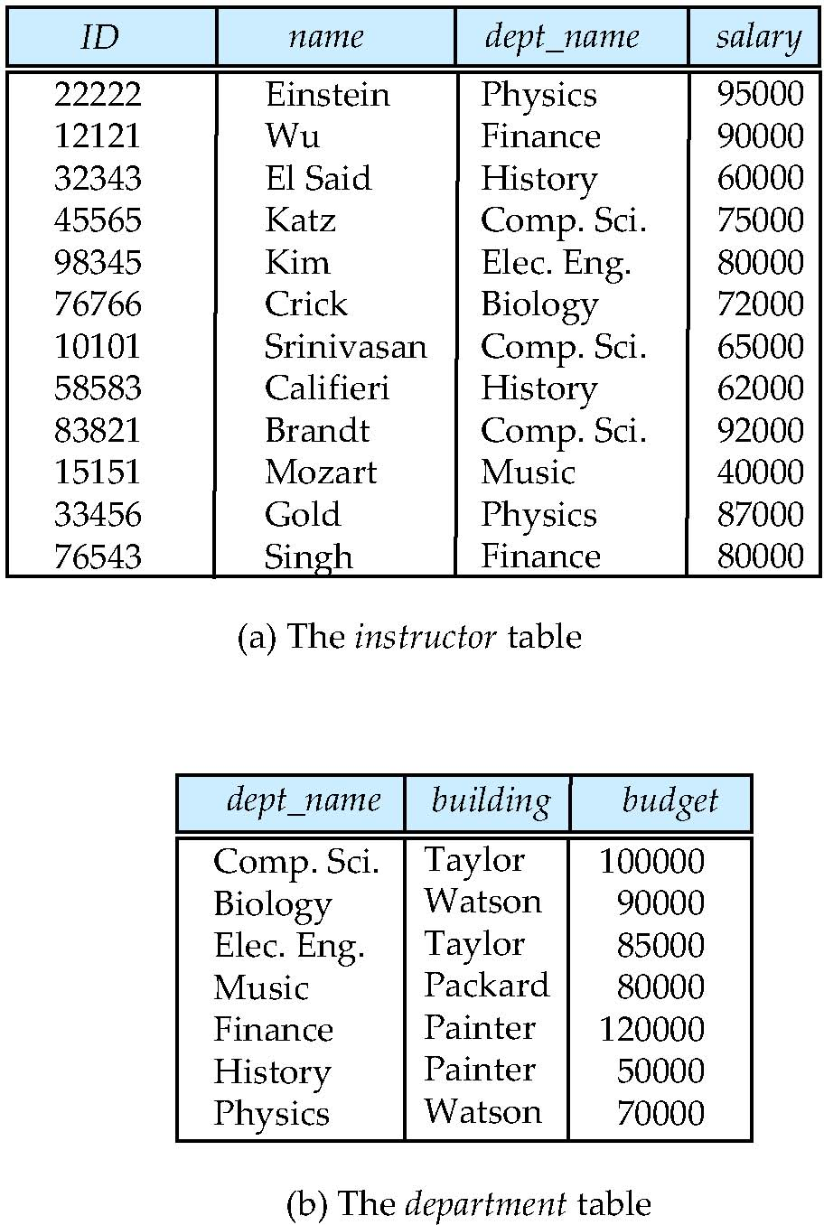
Select Operation
Notation: σ_{p}(r)
p is called the selection predicate
Defined as: σ_{p}(r) = {t | t ∈ r and p(t)} where p is a formula in propositional calculus consisting of terms connected by : ∧ (and), ∨ (or), ¬ (not).
Each term is one of: <attribute> op <attribute> or <attribute> op <constant> where op is one of: =, ≠, >, ≥, <, ≤
Example of selection: σ_{dept_name=“Physics”}(instructor)

Slide 6
Project Operation
Notation: where A₁, A₂,…, A_{k} are attribute names and r is a relation name.
The result is defined as the relation of k columns obtained by erasing the columns that are not listed.
Duplicate rows removed from result, since relations are sets.
Example: To ignore the dept_name attribute of instructor. ∏_{ID, name, salary}(instructor)

Slide 7
Union Operation
Notation: r ∪ s
Defined as: r ∪ s = {t | t ∈ r or t ∈ s}
For r ∪ s to be valid.
r, s must have the same arity (same number of attributes)
The attribute domains must be compatible (example: There is A attribute in both r and s. In r, it is defined as integer (e.g. 123), and in s, it is defined as string (e.g, “123”). They are not compatible.)
Example: to find all courses taught in the Fall 2009 semester, or in the Spring 2010 semester, or in both ∏_{course_id} (σ _{semester=“Fall” Λ year=2009} (section)) ∪ ∏_{course_id} (σ _{semester=“Spring” Λ year=2010} (section))

Slide 8
Set Difference Operation
Notation r – s
Defined as: r – s = {t | t ∈ r and t ∉ s}
Set differences must be taken between compatible relations.
r and s must have the same arity
attribute domains of r and s must be compatible
Example: to find all courses taught in the Fall 2009 semester, but not in the Spring 2010 semester. ∏_{course_id} (σ _{semester=“Fall” Λ year=2009} (section)) − ∏_{course_id} (σ _{semester=“Spring” Λ year=2010} (section))

Slide 9
Cartesian-Product Operation
Notation r x s
Defined as: r x s = {pq | p ∈ r and q ∈ s}
Assume that attributes of r(R) and s(S) are disjoint. (That is, R ∩ S = ∅).
w(W) implies that a relation w following the schema W.
If attributes of r(R) and s(S) are not disjoint, then renaming must be used. Since it happens, we devise a naming schema to distinguish between the attribute names if they are the same in r(A, B) and s(A,C), by attaching the relation name, r.A and s.A (known as dot-notation).

Slide 10
Rename Operation
Allow us to name, and therefore to refer to, the results of relational-algebra expressions.
Allow us to refer to a relation by more than one name.
Example: ρ_{x}(E)
returns the expression E under the name X.
If a relational-algebra expression E has arity n, then
returns the result of expression E under the name X with the attributes renamed to A₁ , A₂ , …., A_{n} .

Slide 11
Example Query
Find the largest salary in the university
Step 1: find instructor salaries that are less than some other instructor salary (i.e. not maximum
using a copy of instructor under a new name d
∏_{instructor.salary} (σ_{instructor.salary < d.salary} (instructor x ρ_{d} (instructor)))
Step 2: Find the largest salary
∏_{salary} (instructor) – ∏_{instructor.salary} (σ_{instructor.salary < d.salary} (instructor x ρ_{d} (instructor)))
instructor
ID | name | dept_name | salary
8 | ABC | SEEM | 100
7 | XYZ | SEEM | 120
I.ID | I.name | I.dept_name | I.salary | d.ID | d.name | d.salary | d.salary
8 | ABC | SEEM | 100 | 8 | ABC | SEEM | 100
8 | ABC | SEEM | 100 | 7 | XYZ | SEEM | 120
7 | XYZ | SEEM | 120 | 8 | ABC | SEEM | 100
7 | XYZ | SEEM | 120 | 7 | XYZ | SEEM | 120

Slide 12
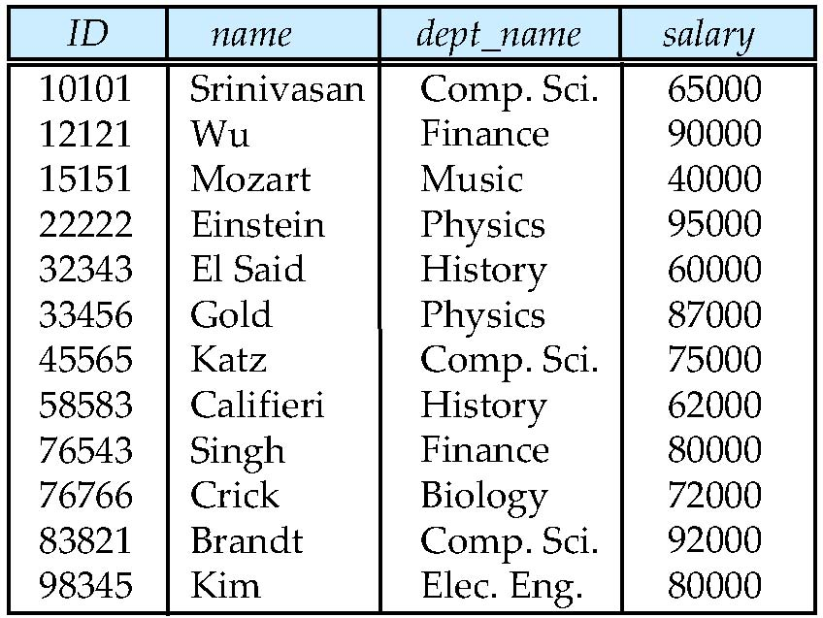
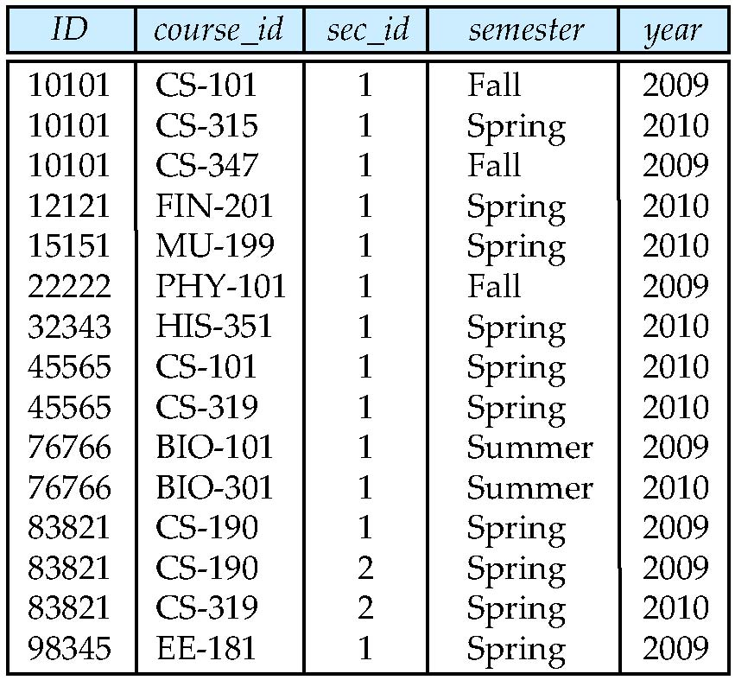
Example Queries
Find the names of all instructors in the Physics department, along with the course_id of all courses they have taught.
Query 1 ∏_{instructor.ID,course_id} (σ_{dept_name=“Physics”} ( σ_{instructor.ID=teaches.ID} (instructor x teaches)))
Query 2 ∏_{instructor.ID,course_id} (σ_{instructor.ID=teaches.ID} ( σ_{dept_name=“Physics”} (instructor) x teaches))
instructor
teaches

Slide 13
Formal Definition
A basic relational algebra expression is:
A relation in the database
A general relational algebra expression is constructed out of smaller subexpressions. Let E₁ and E₂ be relational-algebra expressions; the following are all relational-algebra expressions:
E₁ ∪ E₂
E₁ – E₂
E₁ x E₂
σ_{p} (E₁), P is a predicate on attributes in E₁
∏_{s} (E₁), S is a list consisting of some of the attributes in E₁
ρ_{x} (E₁), x is the new name for the result of E₁

Slide 14
Additional Operations
We define additional operations that do not add an power to the relational algebra, but that simplify common queries.
Set intersection
Natural join
Assignment
Outer join

Slide 15
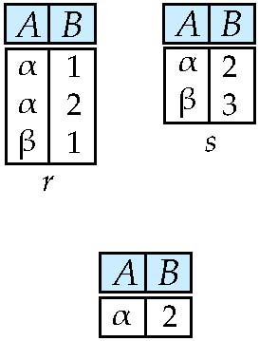
Set-Intersection Operation
Notation: r ∩ s
Defined as:
r ∩ s = { t | t ∈ r and t ∈ s }
Assume:
r, s have the same arity
attributes of r and s are compatible
Note: r ∩ s = r – (r – s)
r ∩ s

Slide 16
Natural-Join Operation
Notation: r s
Let r and s be relations on schemas R and S respectively. Then, r s is a relation on schema R ∪ S obtained as follows:
Consider each pair of tuples t_{r} from r and t_{s} from s.
If t_{r} and t_{s} have the same value on each of the attributes in R ∩ S, add a tuple t to the result, where
t has the same value as t_{r} on r
t has the same value as t_{s} on s
Example:
R = (A, B, C, D)
S = (E, B, D)
Result schema = (A, B, C, D, E)
r s is defined as: ∏_{r.A, r.B, r.C, r.D, s.E} (σ_{r.B = s.B ∧ r.D = s.D} (r x s))

Slide 17
Natural Join and Theta Join
Find the names of all instructors in the Comp. Sci. department together with the course titles of all the courses that the instructors teach
∏ _{name, title} (σ _{dept_name=“Comp. Sci.”} (instructor teaches course))
Natural join is associative
(instructor teaches) course is equivalent to instructor (teaches course)
Natural join is commutative
instruct teaches is equivalent to teaches instructor
The theta join operation r _{θ} s is defined by combing a selection and a Cartesian product into a single operation as
r _{θ} s = σ_{θ} (r x s)

Slide 18
Outer Join
An extension of the join operation that avoids loss of information.
Computes the join and then adds tuples form one relation that does not match tuples in the other relation to the result of the join.
Uses null values:
null signifies that the value is unknown or does not exist

Slide 19
Outer Join – Example
Relation instructor
Relation teaches
ID
name
dept_name
ID
course_id
10101
12121
15151
Srinivasan
Wu
Mozart
Comp. Sci.
Finance
Music
10101
12121
76766
CS-101
FIN-201
BIO-101
Join: instructor teaches
ID
name
dept_name
course_id
10101
12121
Srinivasan
Wu
Comp. Sci.
Finance
CS-101
FIN-201
Left Outer Join: instructor teaches
ID
name
dept_name
course_id
10101
12121
15151
Srinivasan
Wu
Mozart
Comp. Sci.
Finance
Music
CS-101
FIN-201
null

Slide 20
Outer Join – Example
Relation instructor
Relation teaches
ID
name
dept_name
ID
course_id
10101
12121
15151
Srinivasan
Wu
Mozart
Comp. Sci.
Finance
Music
10101
12121
76766
CS-101
FIN-201
BIO-101
Right Outer Join: instructor teaches
ID
name
dept_name
course_id
10101
12121
76766
Srinivasan
Wu
null
Comp. Sci.
Finance
null
CS-101
FIN-201
BIO-101
Full Outer Join: instructor teaches
ID
name
dept_name
course_id
10101
12121
15151
76766
Srinivasan
Wu
Mozart
null
Comp. Sci.
Finance
Music
null
CS-101
FIN-201
null
BIO-101

Slide 21
Outer Join using Joins
A single tuple constant relation for the attributes that only appear in S.
Outer join can be expressed using basic operations
e.g. r s can be written as
(r s) U ((r – ∏_{R}(r s)) x {(null, …, null)})
Instructor (as r(R))
Teaches (as s(S))
ID
name
dept_name
ID
course_id
10101
12121
15151
Srinivasan
Wu
Mozart
Comp. Sci.
Finance
Music
10101
12121
76766
CS-101
FIN-201
BIO-101
Join: instructor teaches
ID
name
dept_name
course_id
10101
12121
Srinivasan
Wu
Comp. Sci.
Finance
CS-101
FIN-201
ID
name
dept_name
course_id
10101
12121
15151
Srinivasan
Wu
Mozart
Comp. Sci.
Finance
Music
CS-101
FIN-201
null
Left Outer Join:
instructor teaches

Slide 22
Null Values
It is possible for tuples to have a null value, denoted by null, for some of their attributes
null signifies an unknown value or that a value does not exist.
The result of any arithmetic expression involving null is null.
Aggregate functions simply ignore null values (as in SQL)
For duplicate elimination and grouping, null is treated like any other value, and two nulls are assumed to be the same (as in SQL)

Slide 23
Null Values
Comparisons with null values return the special truth value: unknown
If false was used instead of unknown, then not (A < 5) would not be equivalent to A >= 5
Three-valued logic using the truth value unknown:
OR: (unknown or true) = true, (unknown or false) = unknown (unknown or unknown) = unknown
AND: (true and unknown) = unknown, (false and unknown) = false, (unknown and unknown) = unknown
NOT: (not unknown) = unknown
Result of select predicate is treated as false if it evaluates to unknown

Slide 24
Reconsider the SQL
Find all students who have taken all courses offered in the Biology department.
select distinct S.ID, S.name
from student as S
where not exists ( (select course_id
from course
where dept_name = ’Biology’)
except
(select T.course_id
from takes as T
where S.ID = T.ID));
Note that X – Y = Ø ⇔ X ⊆ Y
Note: Cannot write this query using = all and its variants

Slide 25
Division Operator
r(R)
s(S)
Given relations r(R) and s(S), such that S ⊂ R, r ÷ s is the largest relation t(R-S) such that t x s ⊆ r
E.g., let:
r(ID, course_id) = ∏_{ID, course_id} (takes)
s(course_id) = ∏_{course_id}(σ_{dept_name=“Biology”}(course))
Then r ÷ s gives us students who have taken all courses in the Biology department
t(R-S)

Slide 26
Consider an Example (1)
Consider a relation r on schema R = (ID, CID), and a relation s on schema S = (CID). Here, ID is for student ids, CID is for course ids, and relation s keeps all the courses offered by Biology.
Find all students who take all Biology courses.
r
s
r(ID, course_id) = ∏_{ID, course_id} (takes)
s(course_id) = ∏_{course_id}(σ_{dept_name=“Biology”}(course))
r ÷ s = {J }
ID | CID
J | Bio1
S | CS2
J | Bio2
S | Bio1
P | EE1
CID
Bio1
Bio2

Slide 27
Division Operator
r(R)
s(S)
Can write r ÷ s as
temp1 ← ∏_{R-S} (r) temp2 ← ∏_{R-S} ((temp1 x s) – ∏_{R-S,S} (r)) result = temp1 – temp2
The result to the right of the ← is assigned to the relation variable on the left of the ←.
May use variable in subsequent expressions.
Note: We have ∏_{R-S,S} (r)). Here, “R-S,S” is for schema not for data.
Suppose R is a relation schema R = (A,B,C,D)
S is a relation schema S = (B,C)
Then R – S, S = (A,B,C,D) – (B,C), (B,C) = (A,D,B,C)
t(R-S)

Slide 28
Consider an Example (2)
r
s
temp1 ← ∏_{R-S} (r) temp2 ← ∏_{R-S} ((temp1 x s) – ∏_{R-S,S} (r)) result = temp1 – temp2
ID | CID
J | Bio1
S | CS2
J | Bio2
S | Bio1
P | EE1
CID
Bio1
Bio2
temp1 x s
temp1
temp1 x s - r
ID | CID
J | Bio1
J | Bio2
S | Bio1
S | Bio2
P | Bio1
P | Bio2
ID
J
S
P
ID | CID
S | Bio2
P | Bio1
P | Bio2

Slide 29
Division Operator
Why do we need to do ∏_{R-S,S} (r )? temp1 ← ∏_{R-S} (r) temp2 ← ∏_{R-S} ((temp1 x s) – ∏_{R-S,S} (r)) result = temp1 – temp2
This is for the following reasons.
The relation schema for “temp1” is ∏_{R-S}
The relation schema for “(temp1 x s)” is ∏_{R-S,S},
In order to do “-” (Set difference), all the attributes must match.

Slide 30
Assignment Operation
The assignment operation (←) provides a convenient way to express complex queries.
And this is different from “rename”.
It allows something to appear in multiple places. temp1 ← ∏_{R-S} (r) temp2 ← ∏_{R-S} ((temp1 x s) – ∏_{R-S,S} (r)) result = temp1 – temp2

Slide 31
Assignment Operation
The assignment operation (←) provides a convenient way to express complex queries.
The evaluation of an assignment does not result in any relation. Rather, the result of the expression to the right of ← is assigned to the relation variable on the left of ←.
Write query as a sequential program consisting of
a series of assignments
followed by an expression whose value is displayed as a result of the query.
Assignment must always be made to a temporary relation variable.

Slide 32
Extended Relational-Algebra-Operations
Generalized Projection
Aggregate Functions

Slide 33
Generalized Projection
Extends the projection operation by allowing arithmetic functions to be used in the projection list.
E is any relational-algebra expression
F₁, F₂, …, F_{n} are arithmetic expressions involving constants and attributes in the schema of E.
Given relation instructor(ID, name, dept_name, salary) where salary is annual salary, get the same information but with monthly salary
∏_{ID, name, dept_name, salary/12} (instructor)

Slide 34

Aggregate Functions and Operations
Aggregation function takes a collection of values and returns a single value as a result.
avg: average value min: minimum value max: maximum value sum: sum of values count: number of values
Aggregate operation in relational algebra
E is any relational-algebra expression
G₁, G₂ …, G_{n} is a list of attributes on which to group (can be empty)
Each F_{i} is an aggregate function
Each A_{i} is an attribute name
Note: Some books/articles use γ instead of (Calligraphic G)

Slide 35
Aggregate Functions (Cont.)
Result of aggregation does not have a name
Can use rename operation to give it a name
For convenience, we permit renaming as part of aggregate operation
_{dept_name} _{avg(salary) as avg_sal} (instructor)

Slide 36
Modification of the Database
The content of the database may be modified using the following operations:
Deletion
Insertion
Updating
All these operations can be expressed using the assignment operator

Slide 37
Multiset Relational Algebra
Relational algebra removes all duplicates
e.g. after projection
Multiset relational algebra retains duplicates, to match SQL semantics
SQL duplicate retention was initially for efficiency, but is now a feature
Multiset relational algebra defined as follows
selection: has as many duplicates of a tuple as in the input, if the tuple satisfies the selection
projection: one tuple per input tuple, even if it is a duplicate
cross product: If there are m copies of t1 in r, and n copies of t2 in s, there are m x n copies of t1.t2 in r x s
Other operators similarly defined
E.g. union: m + n copies, intersection: min(m, n) copies difference: min(0, m – n) copies

Slide 38
SQL and Relational Algebra
select A1, A2, .. An from r1, r2, …, rm where P
is equivalent to the following expression in multiset relational algebra
∏ _{A1, .., An} (σ_{P} (r1 x r2 x .. x rm))
select A1, A2, sum(A3) from r1, r2, …, rm where P group by A1, A2
is equivalent to the following expression in multiset relational algebra
_{A1, A2} _{sum(A3)} (σ _{P} (r1 x r2 x .. x rm)))

Slide 39
SQL and Relational Algebra
More generally, the non-aggregated attributes in the select clause may be a subset of the group by attributes, in which case the equivalence is as follows: select A1, sum(A3) from r1, r2, …, rm where P group by A1, A2
is equivalent to the following expression in multiset relational algebra
∏_{A1,sumA3}( _{A1,A2} _{sum(A3)} _{as sumA3}(σ_{P} (r1 x r2 x .. x rm)))

Slide 40
SQL vs Relational Algebra
SQL is a query language for users to access databases.
Relational algebra is used by the system to process queries.
SQL is built on top of relational algebra with some additional facilities to manipulate data.
For example, displaying data in order.
An SQL query is translated into a relational algebra expression to be processed.
In practice, an end-user does not need to write relational algebra. But the idea of algebra can help an end-user to write a good query.

